Slide 1


12. Security and Ethical Issues
Notes:
NOTE:
To change the image on this slide, select the picture and delete it. Then click the Pictures icon in the placeholder to insert your own image.

Slide 2
Content
12.1 Introduction
12.2 Confidentiality
12.3 Ethical Principles
12.4 Privacy
12.5 Hackers

Slide 3
Objectives
After studying this chapter, the student should be able to:
Define a database and a database management system (DBMS) and describe the components of a DBMS.
Describe the architecture of a DBMS based on the ANSI/SPARC definition.
Define the three traditional database models: hierarchical, networking, and relational.
Describe the relational model and relations.
Understand operations on a relational database based on commands available in SQL.
Describe the steps in database design.
Define ERM and E-R diagrams and explain the entities and relationships in this model.
Define the hierarchical levels of normalization and understand the rationale for normalizing the relations.
List database types other than the relational model.

Slide 4
Objectives (cont)
Define three ethical principles related to the use of computers.
Distinguish between physical and intellectual property and list some types of intellectual property.
Define privacy as related to the use of computers.
Give the definition of a computer crime and discuss types of attacks, motivation for attacks, and how to protect against attacks.
Define hackers and the damage done by them

Slide 5
1 - Introduction

Slide 6
1. Introduction
We are living in the information age. We need to keep information about every aspect of our lives. In other words, information is an asset that has a value like any other asset. As an asset, information needs to be secured from attacks.
To be secure, information needs
to be hidden from unauthorized access (confidentiality),
protected from unauthorized change (integrity),
and available to an authorized entity when it is needed (availability).

Slide 7
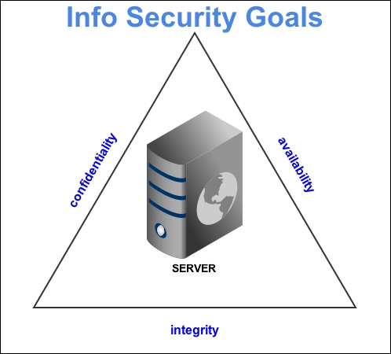
2. Security goals
Confidentiality is probably the most common aspect of information security. We need to protect our confidential information. An organization needs to guard against those malicious actions that endanger the confidentiality of its information.
Integrity Information needs to be changed constantly. In a bank, when a customer deposits or withdraws money, the balance of their account needs to be changed. Integrity means that changes need to be done only by authorized entities and through authorized mechanisms.
Availability The third component of information security is availability. The information created and stored by an organization needs to be available to authorized entities. Information is useless if it is not available. Information needs to be constantly changed, which means it must be accessible to authorized entities.

Slide 8
3. Attacks
Our three goals of security—confidentiality, integrity, and availability—can be threatened by security attacks. Although the literature uses different approaches to categorizing the attacks, we divide them into three groups related to the security goals. Figure 16.1 shows the taxonomy
Figure 12.1 Taxonomy of attacks with relation to security goals

Slide 9
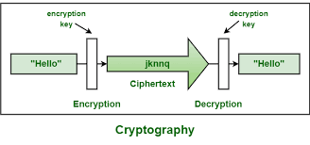
4. Services and techniques
ITU-T defines some security services to achieve security goals and prevent attacks. Each of these services is designed to prevent one or more attacks while maintaining security goals. Two techniques are below
Cryptography (general)
Although in the past cryptography referred only to the encryption and decryption of messages using secret keys.
Steganography (specific)
The word steganography, with origins in Greek, means ‘covered writing’, in contrast to cryptography, which means ‘secret writing’..

Slide 10
2- CONFIDENTIALITY

Slide 11
1. Symmetric-key ciphers
A symmetric-key cipher uses the same key for both encryption and decryption, and the key can be used for bidirectional communication, which is why it is called symmetric. Figure 16.2 shows the general idea behind a symmetric-key cipher.
Figure 12.2 General idea of a symmetric-key cipher

Slide 12
2. Asymmetric-key ciphers
Symmetric- and asymmetric-key ciphers will exist in parallel and continue to serve the community.
In symmetric-key cryptography, the secret must be shared between two persons. In asymmetric-key cryptography, the secret is personal (unshared); each person creates and keeps his or her own secret.
Compare between two system :
And

Slide 13
3. General idea
Figure 12.3 shows the general idea of asymmetric-key cryptography as used for encipherment.
Figure 12.3 General idea of asymmetric-key cryptosystem

Slide 14
R4. SA cryptosystem
Although there are several asymmetric-key cryptosystems, one of the common public-key algorithms is the RSA cryptosystem, named for its inventors (Rivest, Shamir, and Adleman).
RSA uses two exponents, e and d, where e is public and d is private
Figure 12.4 Encryption, decryption, and key generation in RSA

Slide 15
3 - Ethical Principles

Slide 16
1. ETHICAL PRINCIPLES
One of the ways to evaluate our responsibility towards the rest of the world when using a computer is to base our decisions on ethics.
Ethics is a very complex subject that would take several books to describe in detail. In this chapter, we discuss only three principles that can be related to our goal, shown in Figure 12.5.
Figure 12.5 Three main principles of ethics

Slide 17
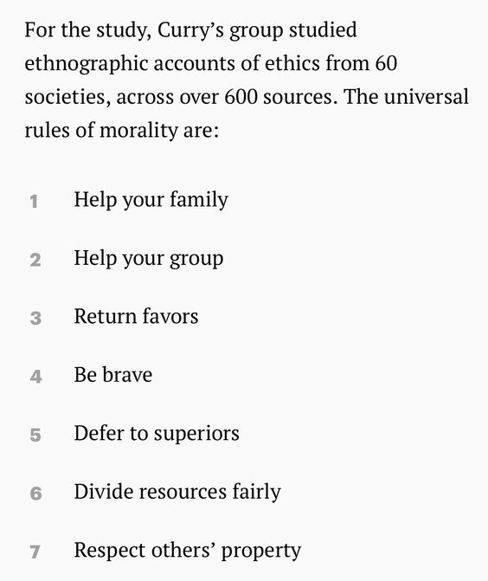
2. Moral rules
The first ethical principle states that when we make an ethical decision, we need to consider if the decision is made in accordance with a universally accepted principle of morality.
For example, if we want to illegally access a computer to get some information, we need to ask ourselves if this act is moral.

Slide 18
3. Utilization
The second theory of ethics is related to the consequences of the act. An act is ethical if it results in consequences which are useful for society.
Example: If a person accesses a bank’s computer and erases customer records, is this act useful for society? Since this action may damage the financial status of the bank’s customer, it is detrimental to society. It does not bring about a good result. It is not ethical.

Slide 19
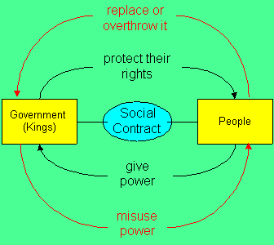
4. Social contract
The social contract theory says that an act is ethical when a majority of people in society agrees with it. If someone breaks into somebody else’s house and commits a robbery, does this act receive the approval of a majority of society? Since the answer is negative, this act is not ethical.
Figure 12.6 Majority of people in society

Slide 20
4- Privacy

Slide 21
1. Introduction
Today, a large amount of personal information about a citizen is collected by private and public agencies. Although in many cases the collection of this information is necessary, it may also pose some risks.
Some of the information collected by government or private companies can be used commercially. In many countries, a citizen’s right to privacy is, directly or indirectly, mentioned in the nation’s constitution.
Codes of ethics related to the use of computers to collect data, as shown below:
1. Collect only data that are needed.
2. Be sure that the collected data are accurate.
3. Allow individuals to know what data have been collected.
4. Allow individuals to correct the collected data if necessary.
5. Be sure that collected data are used only for the original purpose.
6. Use encryption techniques

Slide 22
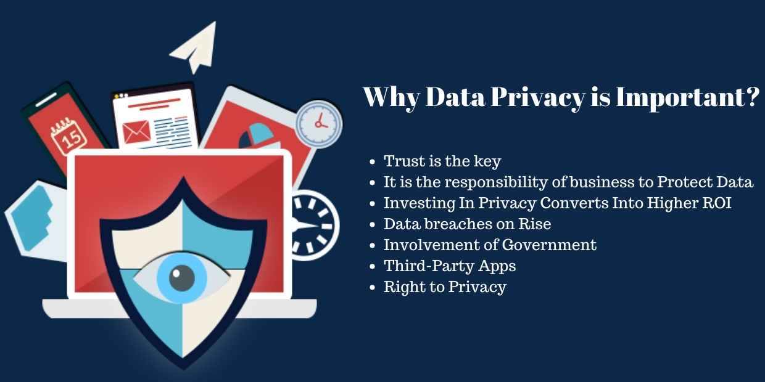
2. Why Data Privacy is important?

Slide 23

4. Non-Disclosure Agreement
A NDA can also be known by other names such as a confidentiality, non-use or trade secret agreement.
Essentially, a non-disclosure (NDA) agreement is a legally binding contract between parties that requires them to keep certain information confidential.
Figure 12.7 An example of NDA

Slide 24
5 - Hackers

Slide 25
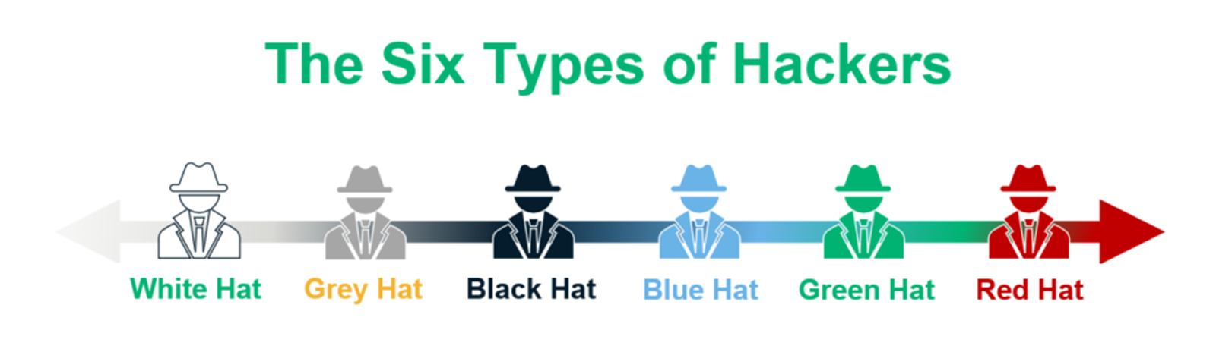
1. Introduction
The word hacker today has a different meaning than when it was used in the past. Previously, a hacker was a person with a lot of knowledge who could improve a system and increase its capability.
Today, a hacker is someone who gains unauthorized access to a computer belonging to someone else in order to copy secret information.
Figure 12.8 Types of Hackers

Slide 26
2. Types of Hackers
Black Hat Hacker Basically, these are the “bad guys”. They are the types of hackers who break into computer networks with purely negative motives such as monetary gain or reputation.
White Hat Hacker As opposed to the black hat, these are the “good guys”. They are ethical hackers who create algorithms to break existing internet networks so as to solve the loopholes in them.
Grey Hat Hacker Basically, these are hackers who exploit the internet systems only to make public, certain vast datasets of information that would be of benefit to everyone.
Blue Hat Hacker In one word, this is the amateur. Usually, their techniques are deployed out of ill motives such as revenge attacks.
Red Hat Hacker The objective of a red hat hacker is to find black hat hackers, intercept and destroy their schemes.
Green Hat Hacker This is the set of individuals who simply want to observe and learn about the world of hacking. It comprises those who join learning communities to watch videos and tutorials about hacking.

Slide 27
3. Common types of hacking
Hacking for financial gain Lone black hat hackers as well as hacking collectives are typically thieves. Their cybercrimes are targeted at either directly stealing money, enabling later theft via data hijacking, or selling the acquired data to other cybercriminals.
Corporate espionage With so many industries as cutthroat as they are, it’s unsurprising that companies are often willing to get dirty to triumph over the competition. Corporate (or industrial) espionage is the commercial application of hacking, malware, phishing, and other unsavory spying techniques to obtain privileged insider information from a business competitor — aka information hacking.
State-sponsored hacking The potential rewards from security hacking can be so great, even governments want to get in on the party. Countries all across the world are constantly playing games of cat-and-mouse cyber warfare with one another. Everyone knows that everyone else is doing it, and everyone acts surprised and offended when they get caught.

